Slide 1
Measures of Central Tendency
Md. Ismail Hossain Riday

Slide 2
Descriptive measures
In previous chapter, we discussed how a raw data set can be organized and summarized by tables and graphs.
Another method of summarizing data set precisely is to compute number (a single number).
Number that can be describe data sets are called descriptive measures

Slide 3
Descriptive measures
Four types of descriptive measure
Measures of central tendency
Measures of Location
Measures of Dispersion
Shape of the distribution

Slide 4
Measures of Central Tendency
It is a summary measure
Attempts to describe the whole data set with a single value
Represents the center of the distribution

Slide 5
Types of C.T.
Mean
Median
Mode

Slide 6
Types of C.T.
Mean
Median
Mode

Slide 7
Types of mean
Arithmetic mean
Geometric mean
Harmonic mean

Slide 8
Arithmetic Mean
It is simply sum of the observations divided by the total number of observations

Slide 9
Arithmetic Mean
It is simply sum of the observations divided by the total number of observations
For example: Consider the values 5, 3, 9, 2, 7, 5, 8

Slide 10
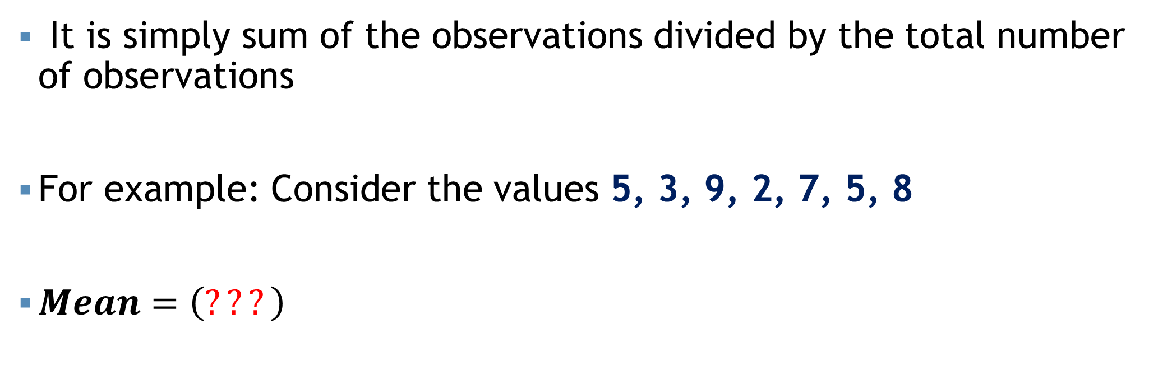
Arithmetic Mean
It is simply sum of the observations divided by the total number of observations
For example: Consider the values 5, 3, 9, 2, 7, 5, 8
$Mean=\left(???\right)$

Slide 11
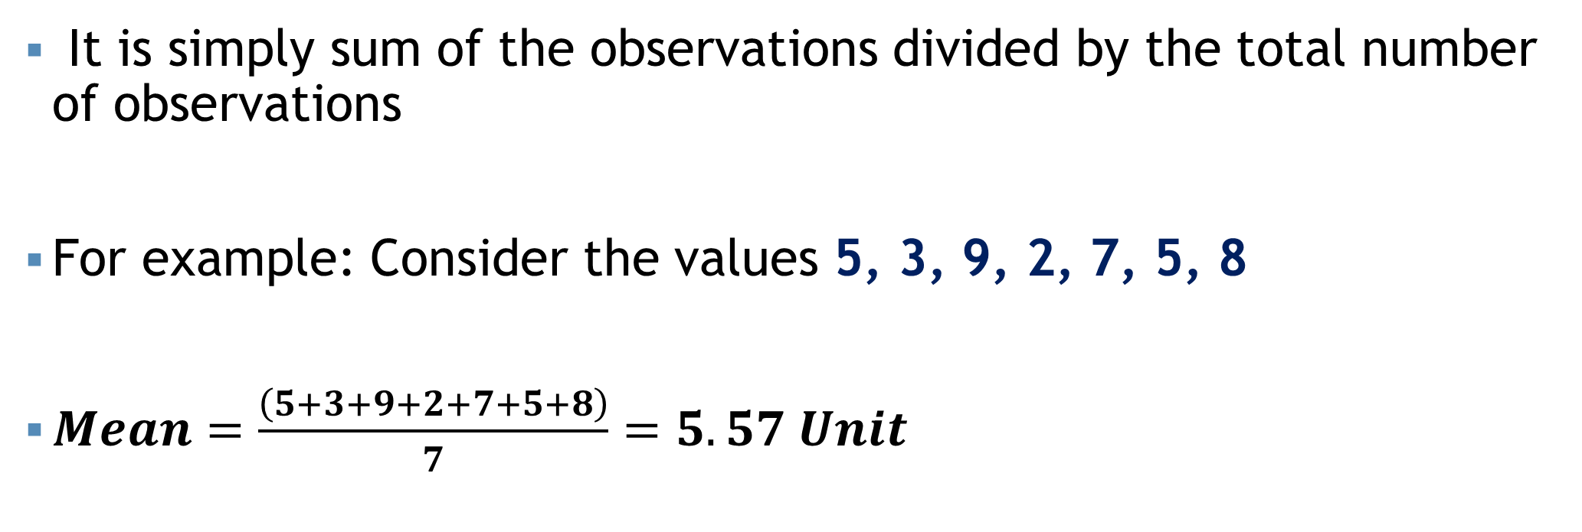
Arithmetic Mean
It is simply sum of the observations divided by the total number of observations
For example: Consider the values 5, 3, 9, 2, 7, 5, 8
$Mean=\frac{\left(5+3+9+2+7+5+8\right)}{7}=5.57 Unit$

Slide 12
Formula: AM
Ungrouped Data | Grouped Data

Slide 13
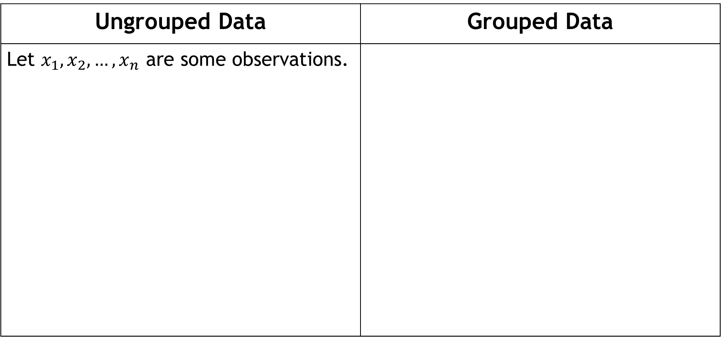
Formula: AM
Ungrouped Data | Grouped Data
Let $x_{1}, x_{2},…, x_{n}$ are some observations.

Slide 14
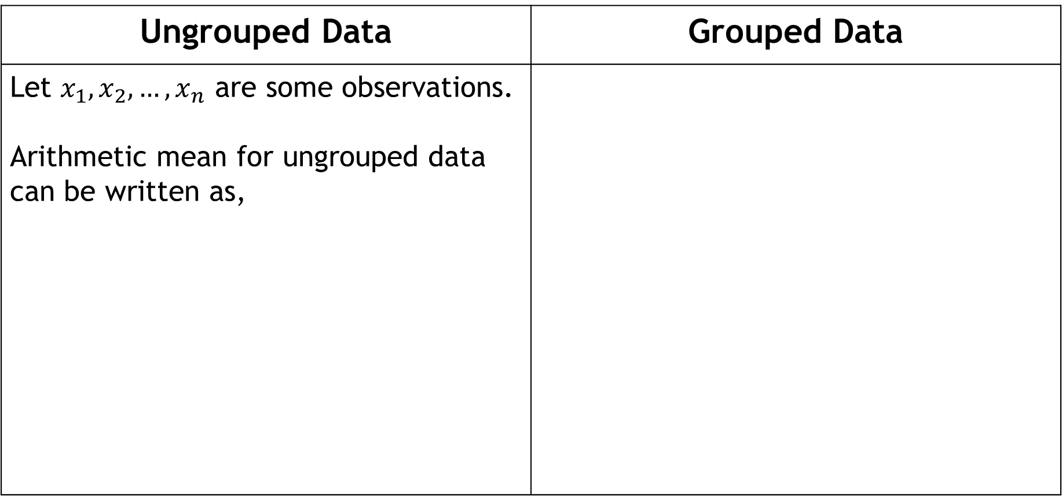
Formula: AM
Ungrouped Data | Grouped Data
Let $x_{1}, x_{2},…, x_{n}$ are some observations. Arithmetic mean for ungrouped data can be written as,

Slide 15
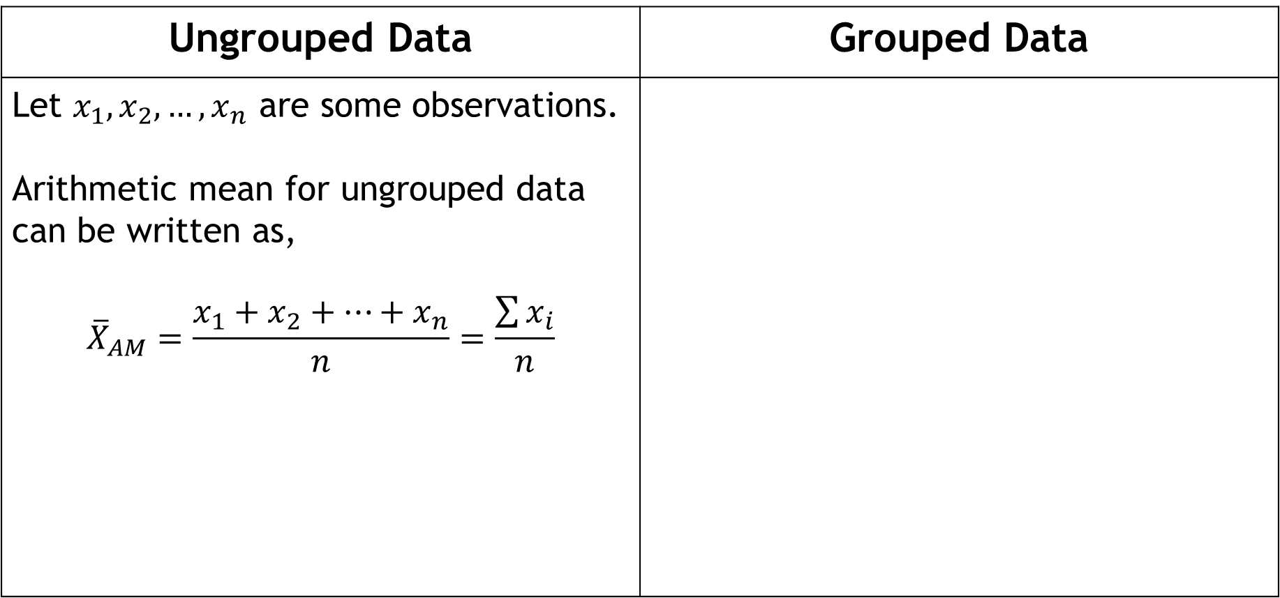
Formula: AM
Ungrouped Data | Grouped Data
Let $x_{1}, x_{2},…, x_{n}$ are some observations. Arithmetic mean for ungrouped data can be written as, $${\overline{X}}_{AM}=\frac{x_{1}+x_{2}+…+x_{n}}{n}=\frac{\sum{x_{i}}}{n}$$

Slide 16
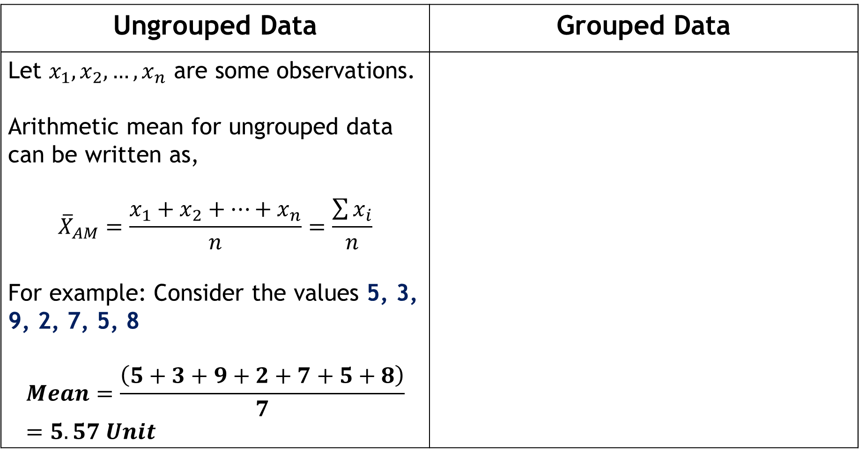
Formula: AM
Ungrouped Data | Grouped Data
Let $x_{1}, x_{2},…, x_{n}$ are some observations. Arithmetic mean for ungrouped data can be written as, $${\overline{X}}_{AM}=\frac{x_{1}+x_{2}+…+x_{n}}{n}=\frac{\sum{x_{i}}}{n}$$ For example: Consider the values 5, 3, 9, 2, 7, 5, 8 $$Mean=\frac{\left(5+3+9+2+7+5+8\right)}{7}=5.57 Unit$$

Slide 17
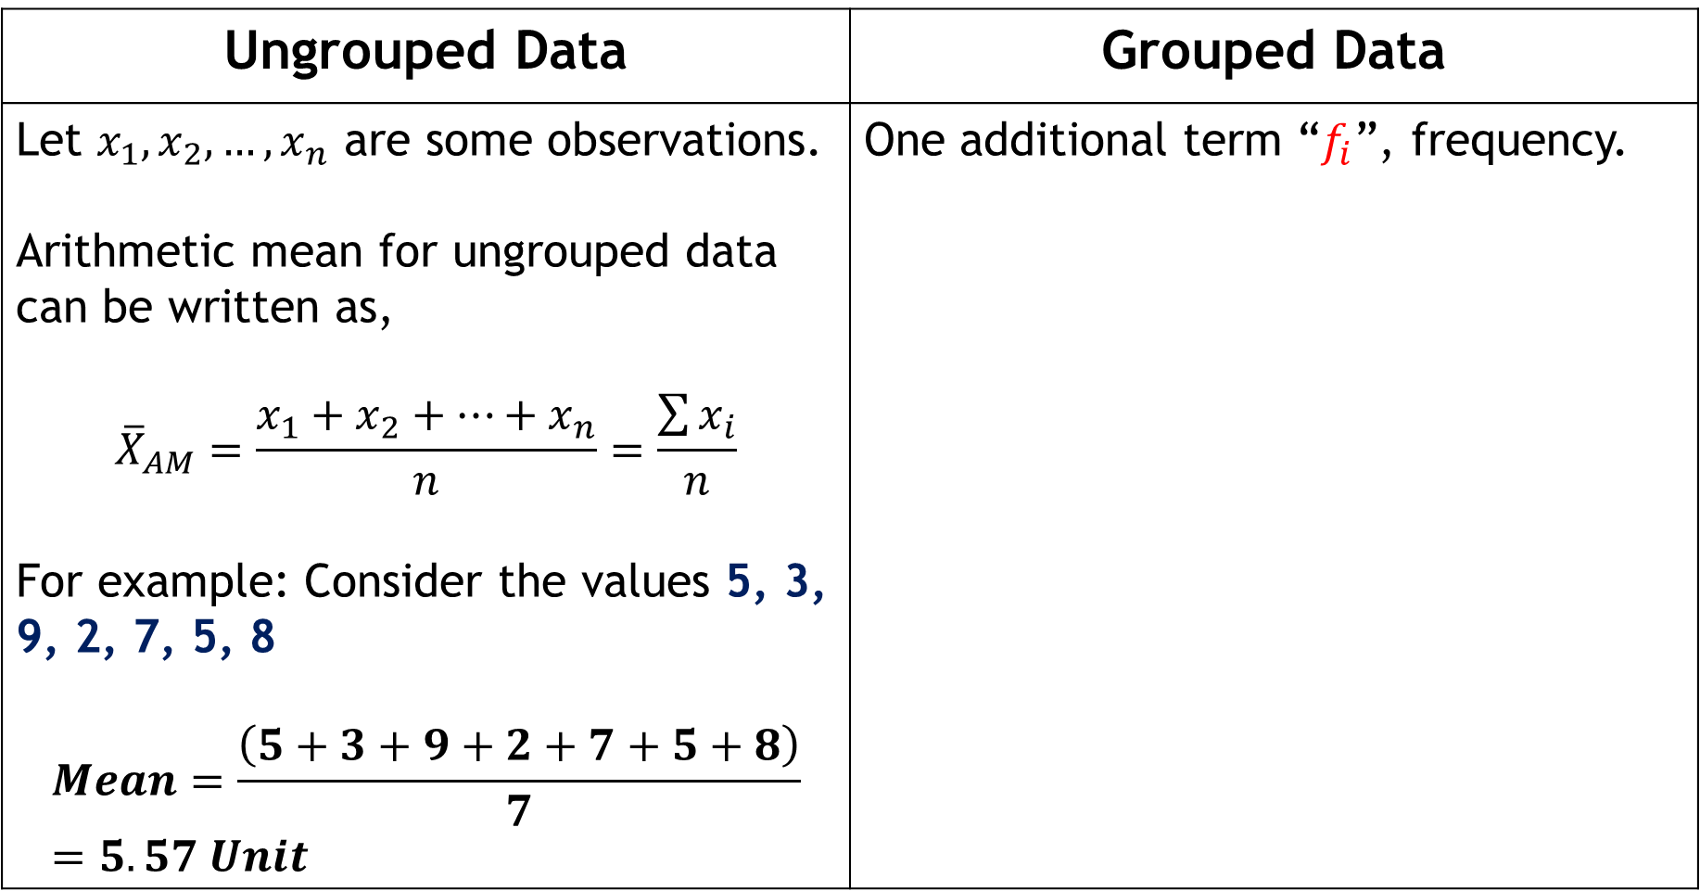
Formula: AM
Ungrouped Data | Grouped Data
Let $x_{1}, x_{2},…, x_{n}$ are some observations. Arithmetic mean for ungrouped data can be written as, $${\overline{X}}_{AM}=\frac{x_{1}+x_{2}+…+x_{n}}{n}=\frac{\sum{x_{i}}}{n}$$ For example: Consider the values 5, 3, 9, 2, 7, 5, 8 $$Mean=\frac{\left(5+3+9+2+7+5+8\right)}{7}=5.57 Unit$$ | One additional term “$f_{i}$”, frequency.

Slide 18
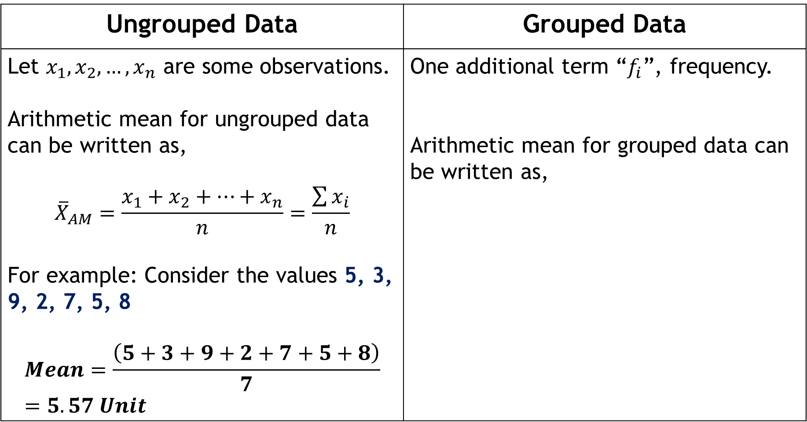
Formula: AM
Ungrouped Data | Grouped Data
Let $x_{1}, x_{2},…, x_{n}$ are some observations. Arithmetic mean for ungrouped data can be written as, $${\overline{X}}_{AM}=\frac{x_{1}+x_{2}+…+x_{n}}{n}=\frac{\sum{x_{i}}}{n}$$ For example: Consider the values 5, 3, 9, 2, 7, 5, 8 $$Mean=\frac{\left(5+3+9+2+7+5+8\right)}{7}=5.57 Unit$$ | One additional term “$f_{i}$”, frequency. Arithmetic mean for grouped data can be written as,

Slide 19
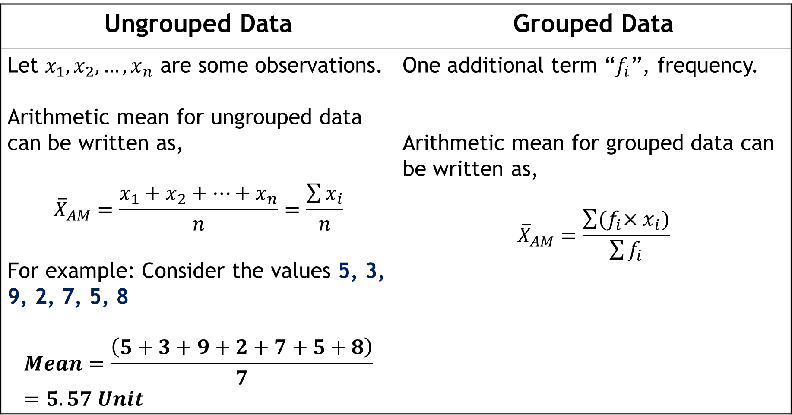
Formula: AM
Ungrouped Data | Grouped Data
Let $x_{1}, x_{2},…, x_{n}$ are some observations. Arithmetic mean for ungrouped data can be written as, $${\overline{X}}_{AM}=\frac{x_{1}+x_{2}+…+x_{n}}{n}=\frac{\sum{x_{i}}}{n}$$ For example: Consider the values 5, 3, 9, 2, 7, 5, 8 $$Mean=\frac{\left(5+3+9+2+7+5+8\right)}{7}=5.57 Unit$$ | One additional term “$f_{i}$”, frequency. Arithmetic mean for grouped data can be written as, $${\overline{X}}_{AM}=\frac{\sum{{(f}_{i}×x_{i})}}{\sum{f_{i}}}$$

Slide 20
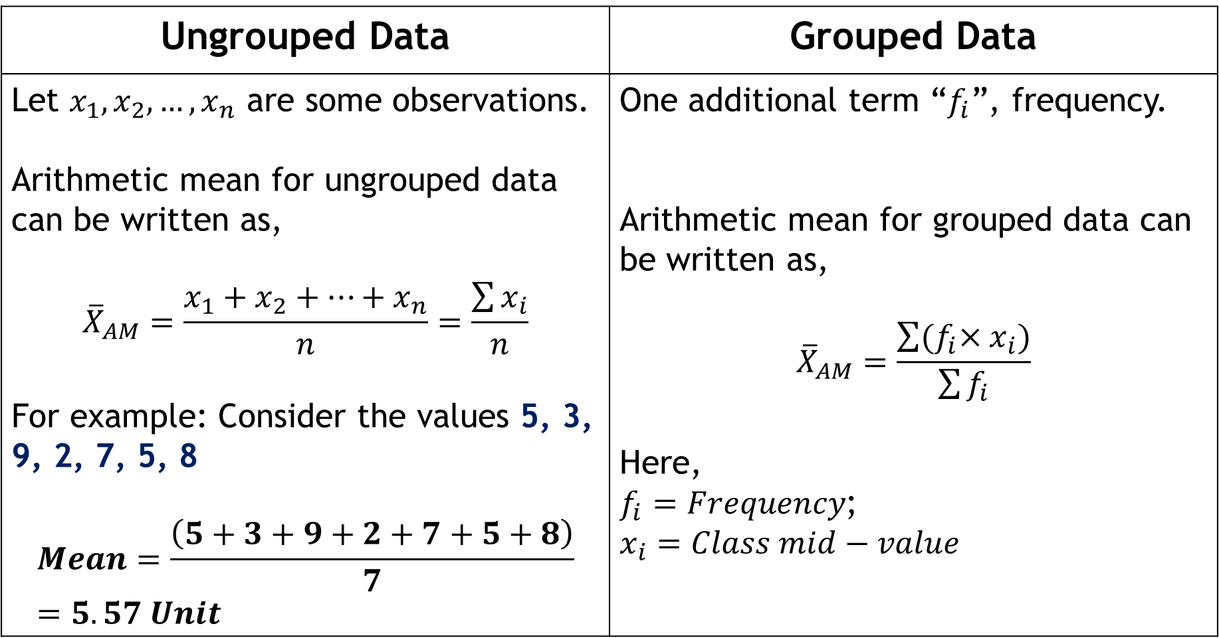
Formula: AM
Ungrouped Data | Grouped Data
Let $x_{1}, x_{2},…, x_{n}$ are some observations. Arithmetic mean for ungrouped data can be written as, $${\overline{X}}_{AM}=\frac{x_{1}+x_{2}+…+x_{n}}{n}=\frac{\sum{x_{i}}}{n}$$ For example: Consider the values 5, 3, 9, 2, 7, 5, 8 $$Mean=\frac{\left(5+3+9+2+7+5+8\right)}{7}=5.57 Unit$$ | One additional term “$f_{i}$”, frequency. Arithmetic mean for grouped data can be written as, $${\overline{X}}_{AM}=\frac{\sum{{(f}_{i}×x_{i})}}{\sum{f_{i}}}$$ Here, $f_{i}=Frequency$; $x_{i}=Class mid−value$

Slide 21
Group data: AM
Class | Frequency
5-9 | 4
9-13 | 3
13-17 | 3
17-21 | 3

Slide 22
Group data: AM
Class | Frequency
5-9 | 4
9-13 | 3
13-17 | 3
17-21 | 3
Calculate mean from this table…

Slide 23
Group data: AM
Class | Frequency
5-9 | 4
9-13 | 3
13-17 | 3
17-21 | 3
Calculate mean or arithmetic mean from this table…

Slide 24
Group data: AM
Class | Frequency
5-9 | 4
9-13 | 3
13-17 | 3
17-21 | 3
Calculate mean or arithmetic mean or average from this table…

Slide 25
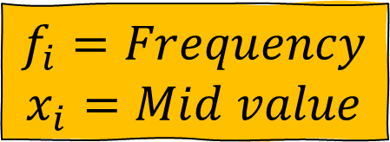
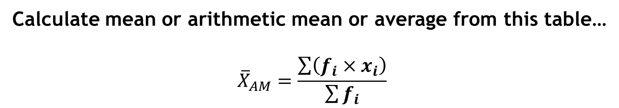
Group data: AM
Class | Frequency
5-9 | 4
9-13 | 3
13-17 | 3
17-21 | 3
$$f_{i}=Frequency$$
$$x_{i}=Mid value$$
Calculate mean or arithmetic mean or average from this table…
$${\overline{X}}_{AM}=\frac{\sum{\left(f_{i}×x_{i}\right)}}{\sum{f_{i}}}$$

Slide 26
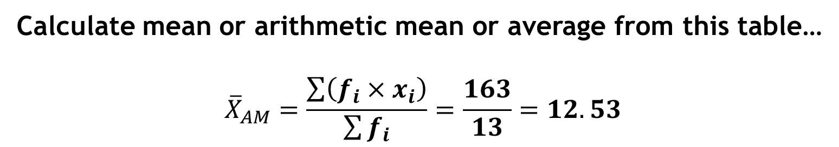
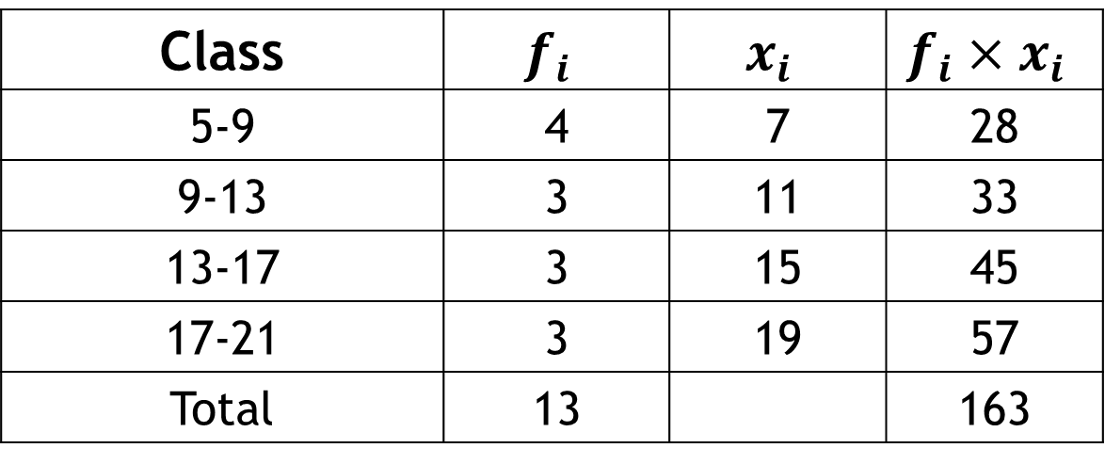
Group data: AM
Class | $$f_{i}$$ | $$x_{i}$$ | $$f_{i}×x_{i}$$
5-9 | 4 | 7 | 28
9-13 | 3 | 11 | 33
13-17 | 3 | 15 | 45
17-21 | 3 | 19 | 57
Total | 13 |  | 163
Calculate mean or arithmetic mean or average from this table…
$${\overline{X}}_{AM}=\frac{\sum{\left(f_{i}×x_{i}\right)}}{\sum{f_{i}}}=\frac{163}{13}=12.53$$

Slide 27
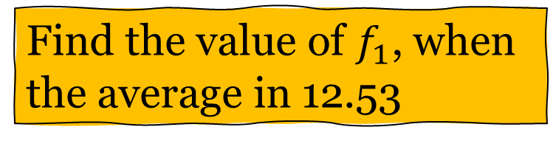
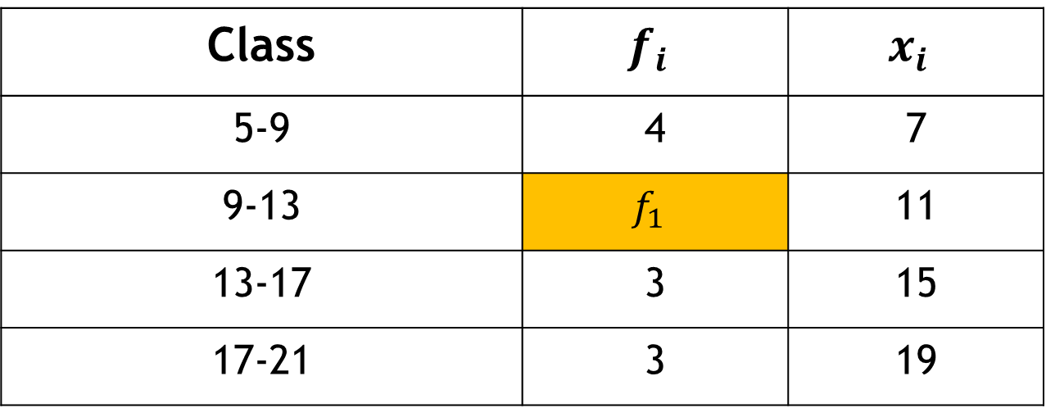
Group data: AM
Class | $$f_{i}$$ | $$x_{i}$$
5-9 | 4 | 7
9-13 | $$f_{1}$$ | 11
13-17 | 3 | 15
17-21 | 3 | 19
Find the value of $f_{1}$, when the average in 12.53

Slide 28
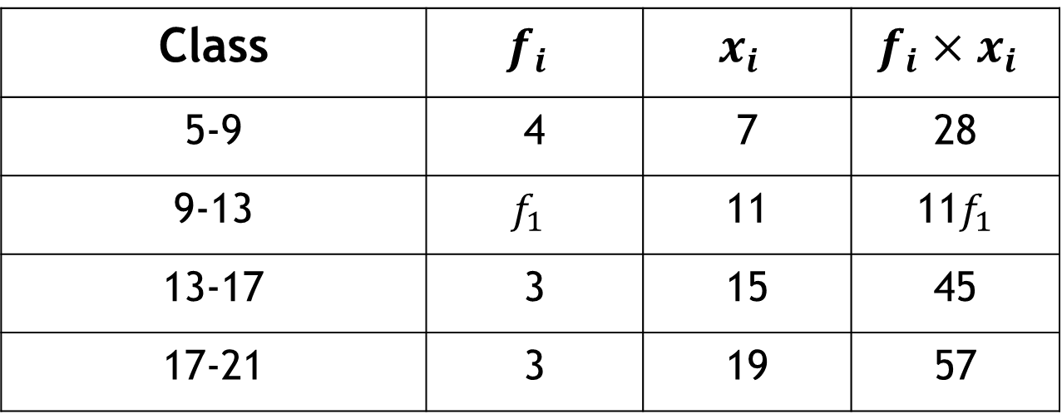
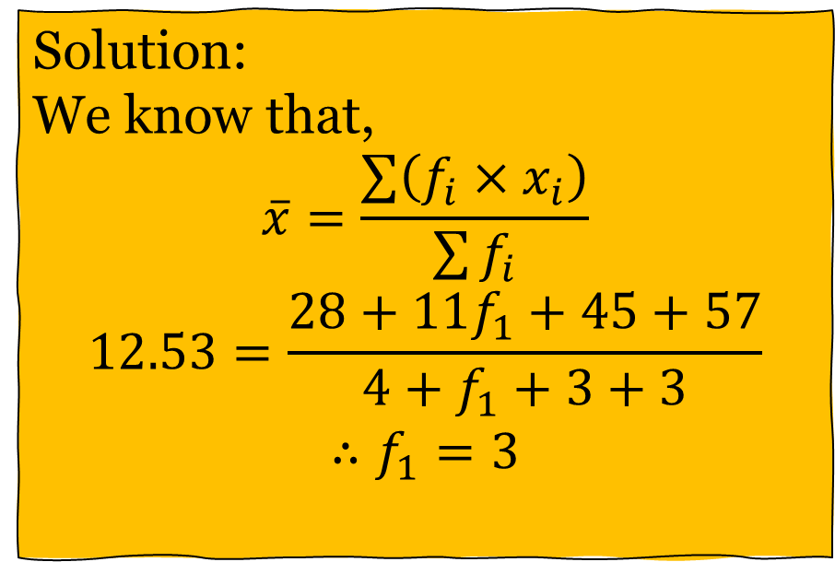
Group data: AM
Class | $$f_{i}$$ | $$x_{i}$$ | $$f_{i}×x_{i}$$
5-9 | 4 | 7 | 28
9-13 | $$f_{1}$$ | 11 | 11$f_{1}$
13-17 | 3 | 15 | 45
17-21 | 3 | 19 | 57
Solution:
We know that,
$$\overline{x}=\frac{\sum{\left(f_{i}×x_{i}\right)}}{\sum{f_{i}}}$$
$$12.53=\frac{28+11f_{1}+45+57}{4+f_{1}+3+3}$$
$$∴f_{1}=3$$
Find the value of $f_{1}$, when the average in 12.53

Slide 29
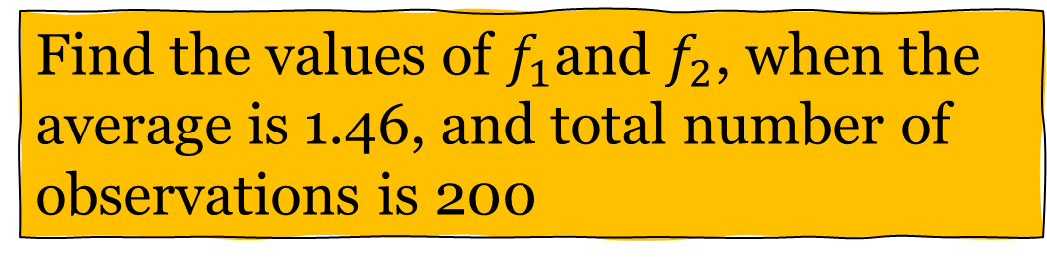
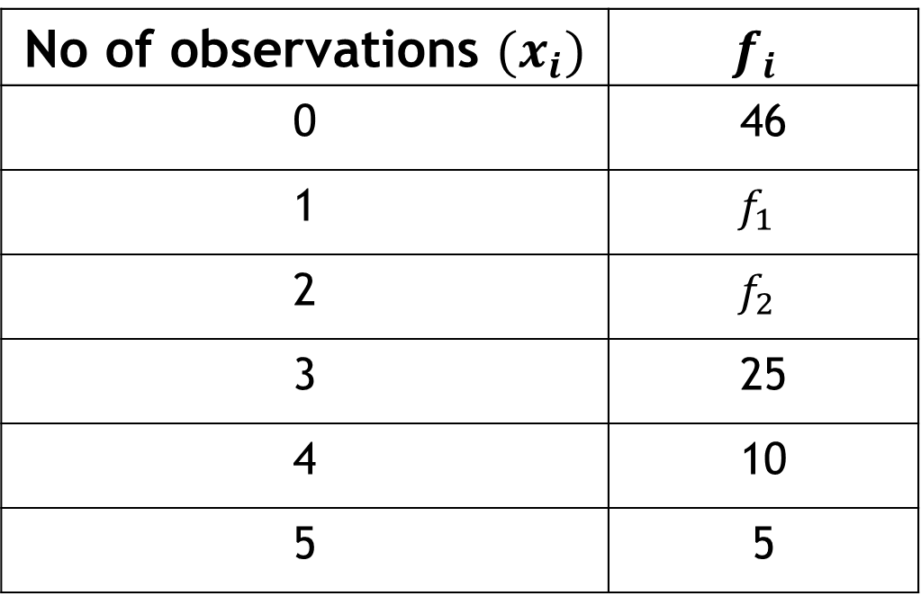
Self Practice
No of observations $(x_{i})$ | $$f_{i}$$
0 | 46
1 | $$f_{1}$$
2 | $$f_{2}$$
3 | 25
4 | 10
5 | 5
Find the values of $f_{1}$and $f_{2}$, when the average is 1.46, and total number of observations is 200

Slide 30
Geometric Mean
It is useful when dealing with data that exhibits
Exponential growth, or
Growth over the year/ change over a period of times, or
Geometric progression

Slide 31
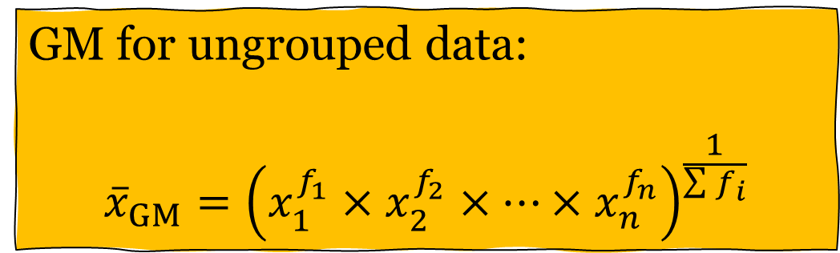
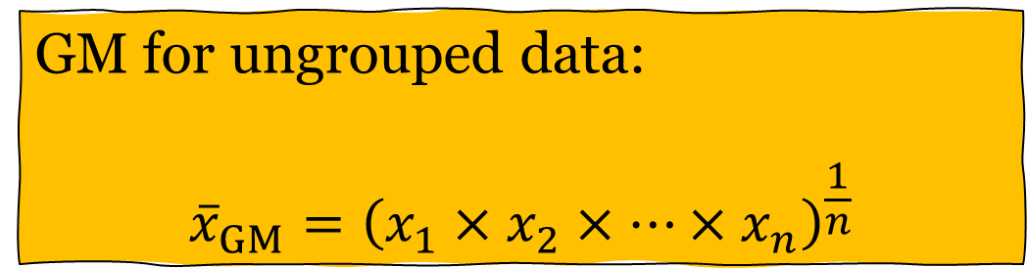
Geometric Mean
GM for ungrouped data:
$${\overline{x}}_{GM}={\left(x_{1}×x_{2}×…×x_{n}\right)}^{\frac{1}{n}}$$
GM for ungrouped data:
$${\overline{x}}_{GM}={\left(x_{1}^{f_{1}}×x_{2}^{f_{2}}×…×x_{n}^{f_{n}}\right)}^{\frac{1}{\sum{f_{i}}}}$$

Slide 32

Geometric Mean
For example: 5, 3, 9, 2, 7, 5, 8
${\overline{X}}_{GM}={\left(5×3×9×2×7×5×8\right)}^{\frac{1}{7}}=4.98$

Slide 33
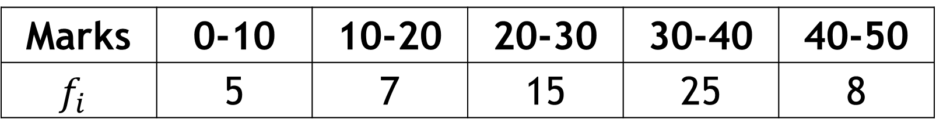
Geometric Mean
Find the geometric mean for the following distribution:
Marks | 0-10 | 10-20 | 20-30 | 30-40 | 40-50
$$f_{i}$$ | 5 | 7 | 15 | 25 | 8

Slide 34

Geometric Mean
If $x_{i}$ are the percent value (rate) for a given time t,
$${Average growth rate=\left\{\left(1+r_{1}\right)×\left(1+r_{2}\right)×…×\left(1+r_{n}\right)\right\}}^{\frac{1}{n}}−1$$
$${Average depreciation rate=\left\{\left(1−r_{1}\right)×\left(1−r_{2}\right)×…×\left(1−r_{n}\right)\right\}}^{\frac{1}{n}}−1$$

Slide 35
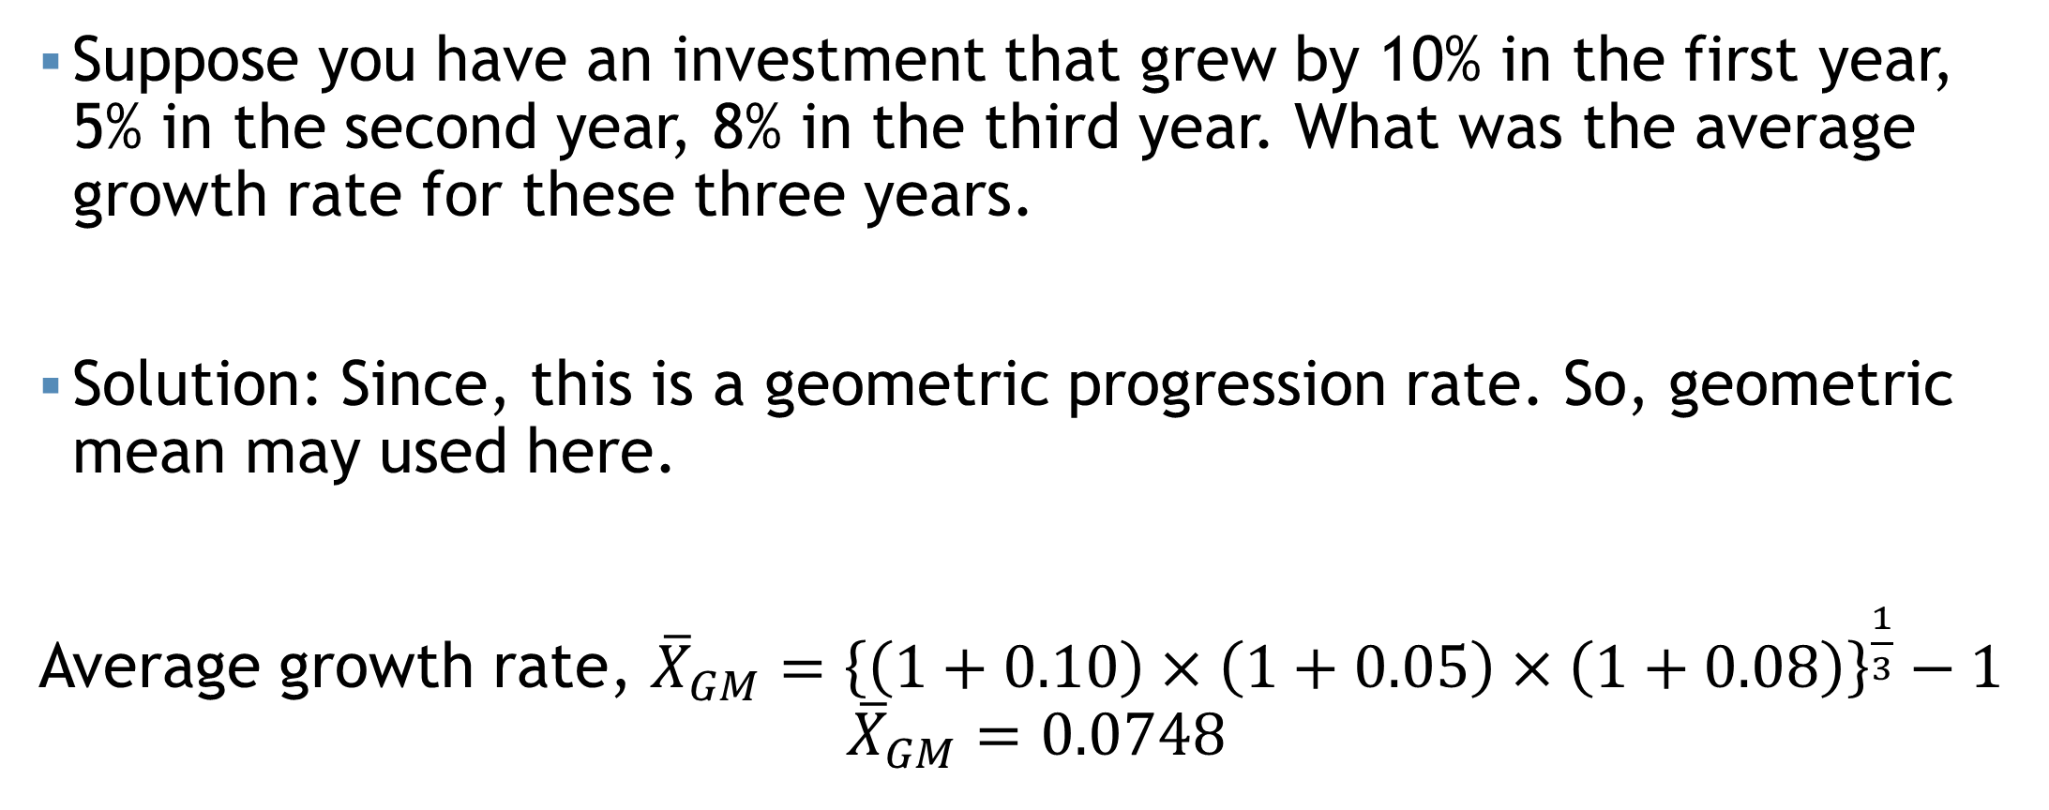
Geometric Mean
Suppose you have an investment that grew by 10% in the first year, 5% in the second year, 8% in the third year. What was the average growth rate for these three years.
Solution: Since, this is a geometric progression rate. So, geometric mean may used here.
Average growth rate, ${\overline{X}}_{GM}={\left\{\left(1+0.10\right)×\left(1+0.05\right)×\left(1+0.08\right)\right\}}^{\frac{1}{3}}−1$
$${\overline{X}}_{GM}=0.0748$$
Comment: Thus, the average growth rate is 7.48%

Slide 36
Geometric Mean
Let’s consider an assets that depreciated by 15% in the first year, 8% in the second year, and 12% in the third year. What was the average depreciation rate over these three years.
Ans: 10.41%
$${Average depreciation rate=\left\{\left(1−r_{1}\right)×\left(1−r_{2}\right)×…×\left(1−r_{n}\right)\right\}}^{\frac{1}{n}}−1$$

Slide 37
Harmonic Mean
It is necessary to compute the average of some variables such as the average speed, average velocity, and so on.

Slide 38
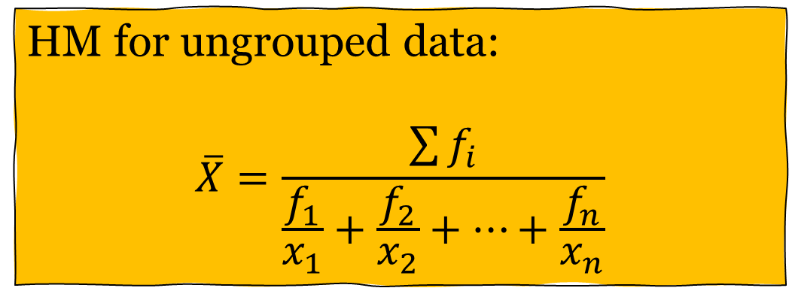
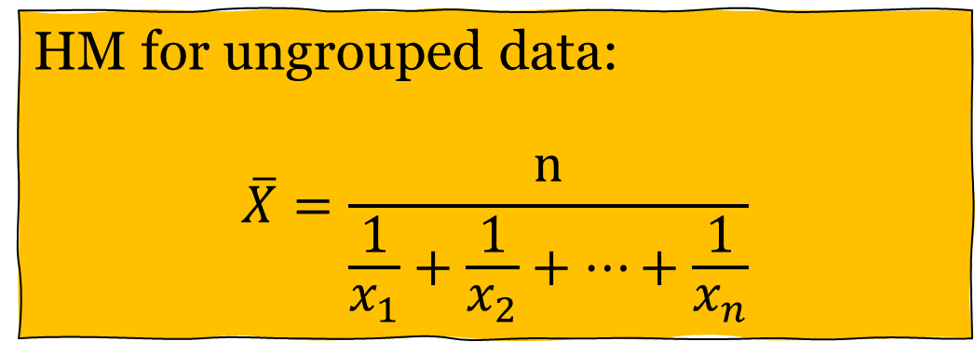
Harmonic Mean
HM for ungrouped data:
$$\overline{X}=\frac{n}{\frac{1}{x_{1}}+\frac{1}{x_{2}}+…+\frac{1}{x_{n}}}$$
HM for ungrouped data:
$$\overline{X}=\frac{\sum{f_{i}}}{\frac{f_{1}}{x_{1}}+\frac{f_{2}}{x_{2}}+…+\frac{f_{n}}{x_{n}}}$$

Slide 39

Harmonic Mean
For example: 5, 3, 9, 2, 7, 5, 8
${\overline{X}}_{HM}=\frac{7}{\frac{1}{5}+\frac{1}{3}+…+\frac{1}{8}}=(???)$

Slide 40
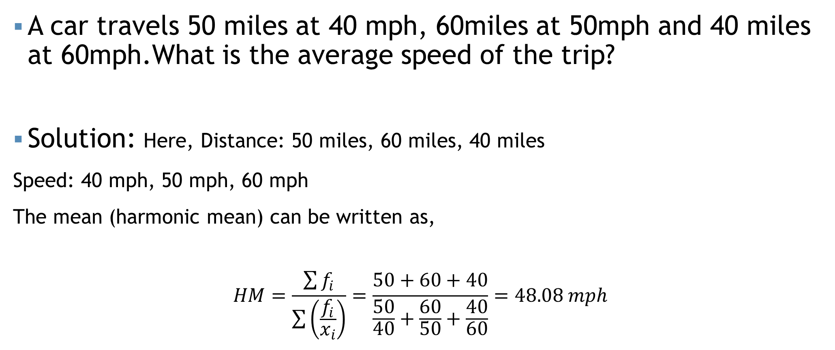
Harmonic Mean
A car travels 50 miles at 40 mph, 60miles at 50mph and 40 miles at 60mph.What is the average speed of the trip?
Solution: Here, Distance: 50 miles, 60 miles, 40 miles
Speed: 40 mph, 50 mph, 60 mph
The mean (harmonic mean) can be written as,
$$HM=\frac{\sum{f_{i}}}{\sum{\left(\frac{f_{i}}{x_{i}}\right)}}=\frac{50+60+40}{\frac{50}{40}+\frac{60}{50}+\frac{40}{60}}=48.08 mph$$

Slide 41
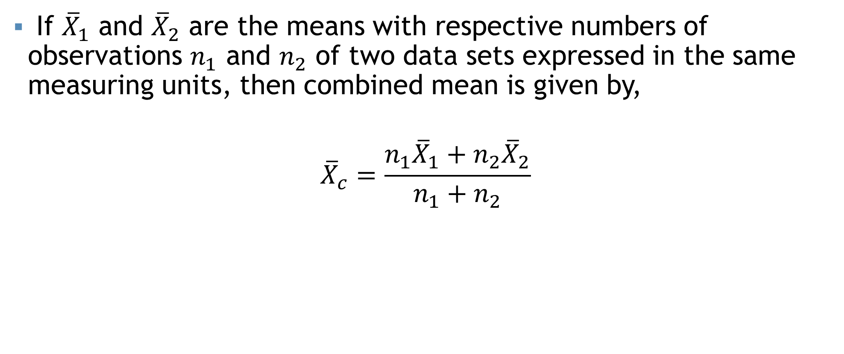
Combined Mean
If ${\overline{X}}_{1}$ and ${\overline{X}}_{2}$ are the means with respective numbers of observations $n_{1}$ and $n_{2}$ of two data sets expressed in the same measuring units, then combined mean is given by,
$${\overline{X}}_{c}=\frac{n_{1}{\overline{X}}_{1}+n_{2}{\overline{X}}_{2}}{n_{1}+n_{2}}$$

Slide 42
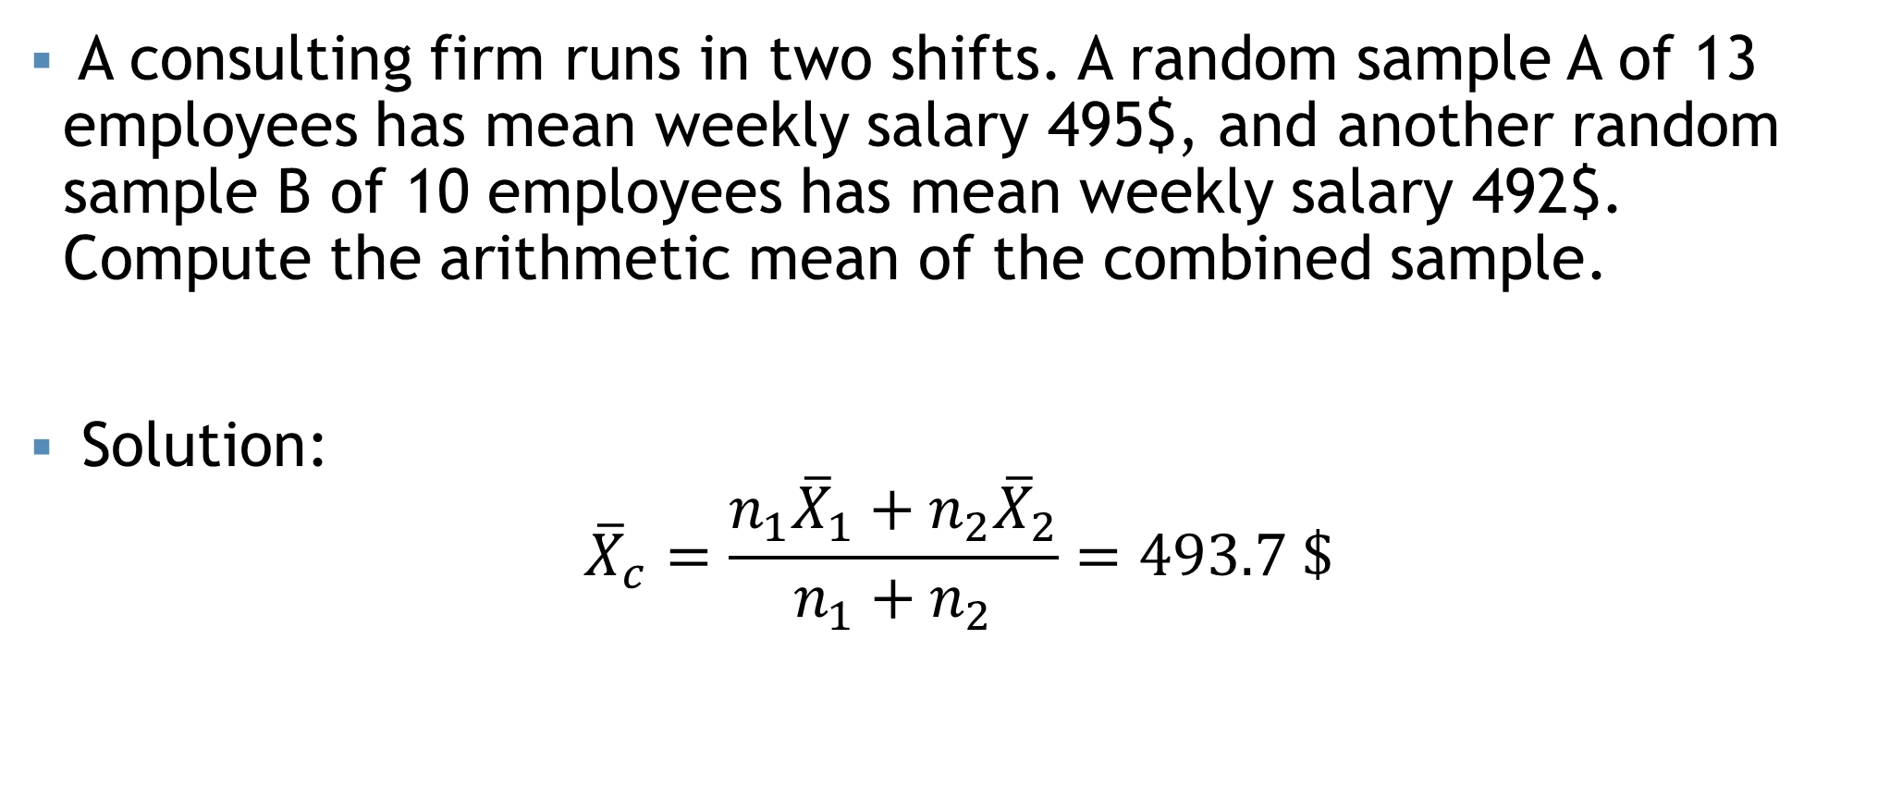
Combined Mean
A consulting firm runs in two shifts. A random sample A of 13 employees has mean weekly salary 495$, and another random sample B of 10 employees has mean weekly salary 492$. Compute the arithmetic mean of the combined sample.
Solution:
$${\overline{X}}_{c}=\frac{n_{1}{\overline{X}}_{1}+n_{2}{\overline{X}}_{2}}{n_{1}+n_{2}}=493.7 \$$$

Slide 43

Some points…
$AM≥GM≥HM$
$GM=\sqrt{AM×HM}$

Slide 44
Weighted mean
The weighted mean is a special case of the arithmetic mean. It occurs when there are several observations of the same value.
To explain- Suppose the Shumi’s Hot Cake offers three different kinds of burger packages small, medium and large for Tk. 100, Tk. 125 and Tk. 150. Of the last 10 burgers sold 3 were small, 4 were medium and 3 were large. To find the mean price of the last 10 burger packages sold we can calculate using the usual formula of the arithmetic mean as follows
$${\overline{X}}_{AM}=\frac{\left(100+100+100+125+125+125+125+150+150+150\right)}{10}=125$$

Slide 45
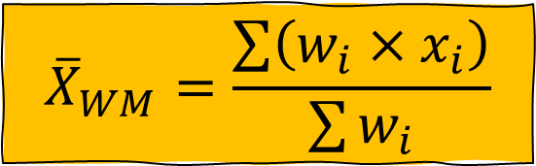
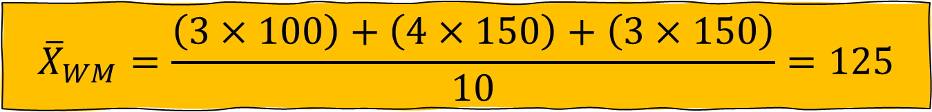
Weighted mean
$${\overline{X}}_{WM}=\frac{\sum{\left(w_{i}×x_{i}\right)}}{\sum{w_{i}}}$$
An easier way to find the mean selling price is to determine the weighted mean.
$${\overline{X}}_{WM}=\frac{\left(3×100\right)+\left(4×150\right)+\left(3×150\right)}{10}=125$$

Slide 46
Weighted mean
Madina Construction Company pays its part time employees hourly basis. For different level of employee, the hourly rate is Tk 50, Tk 75 and Tk 90. There are 260 hourly employees, 140 of which are paid at Tk 50 rate, 100 at Tk 75 and 20 at the Tk 90 rate What is the mean hourly rate paid to the employees?

Slide 47
Mathematical exercise
To access additional mathematical problems, please refer to the PDF lecture notes.

Slide 48
Thank You

